Slide 1
ANALYSIS OF CUSTOMER SERVICE DATA OF NILE
Graded project on ms-excel
Created by aneesh sharma
abads-batch-11

Slide 2

Objectives of the Customer Service Data Centre of NILE:-
Business understanding.
DATA UNDERSTANDING.
DATA PREPARATION
MODELLING OF DATABASE
EVALUATION.
DEPLOYMENT OF DATABASE.

Slide 3

Business Understanding:-
The analysis aims to leverage data-driven approaches to optimize customer service processes, enhance customer experience, and drive overall business growth.
By examining historical customer service data, the project seeks to identify patterns, trends, and opportunities for improvement, ultimately leading to enhanced customer loyalty and increased operational efficiency.

Slide 4
Data Understanding:-
Data understanding involves accessing the data and exploring it using tables and graphics that can be organized in IBM® SPSS® Modeler using the CRISP-DM project tool. FOLLOWING DATA IS PROVIDED BY THE CLIENT :-
ID:- ID of the customer
Customer name:- Name of the customer
Sentiment : - Sentiment of the customer (Neutral, Positive, Very Positive, Negative, Very Negative)
Csat score:- Customer Satisfaction Score (Scale of 1 to 10, 1 being lowest & 10 being Highest)
Call timestamp: Date on which the call was made by the customer.
reason: Reason why the customer called (Billing Question, Service Outage & Payments)
city: City to which the customer belongs
state: State to which the customer belongs

Slide 5
Data Understanding:-
channel: Mode of communication that customer used (Call-center, Chatbot, Email, Web)
response_time: How fast the customer request was serviced (SLA level,Above SLA, Below SLA, Within SLA)
call duration in minutes: Duration of the call
call_center: Location of the call center where service request was handled

Slide 6

Data Preparation:-
Data preparation is the process of preparing raw data so that it is suitable for further processing and analysis .this involves:-
Converting data to proper format.
Removal of blank spaces from column.
Converting different attributes to correct form of data.

Slide 7
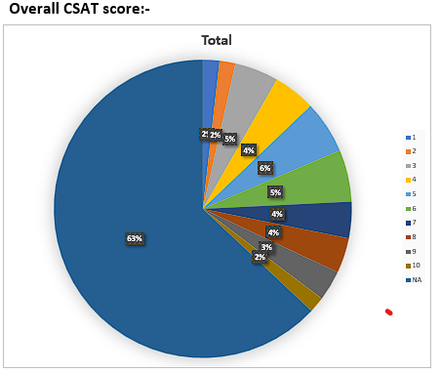
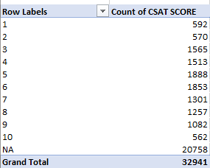
Modelling of Database:-
Data modeling is a process of creating a conceptual representation of data objects and their relationships to one another.
MS EXCEL SOFTWARE IS USED TO CREATE DASHBOARD IN WHICH FURTHER TOOLS ARE USED:-
PIVOT TABLES.
PIVOT CHARTS.
PIE CHARTS.
SLICERS.
VBA TOOL.
VLOOKUP FUNCTIONS.

Slide 8
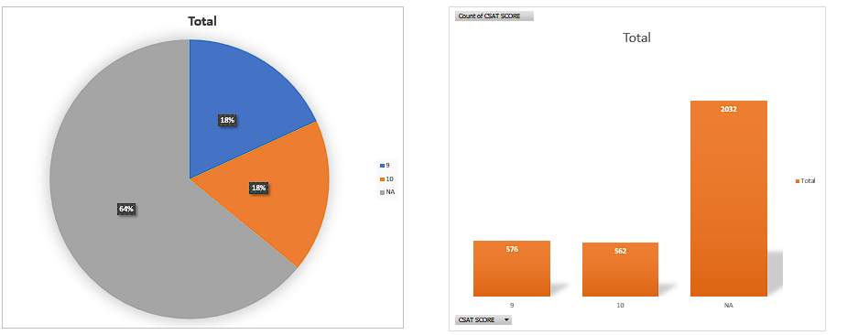
Evaluation of Database:-
OVERALL COMAPRISION OF ALL CSAT SCORE WAS SHOWN .IT WAS FOUND THAT MANY CUSTOMER DIDN’T PROVIDE CSAT SCORE ,ALTHOUGH MANY CUSTOMER HAVE VERY POSITIVE SENTIMENT.

Slide 9
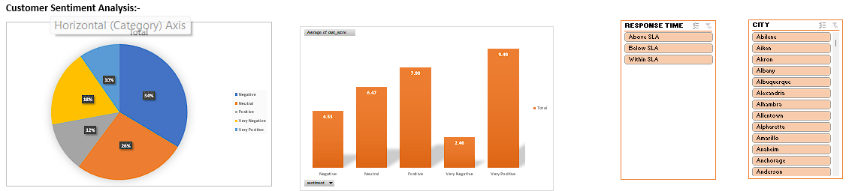
Evaluation of Database:-
Evaluation of Modelling is done keeping in mind the following objectives:-
Customer Sentiment Analysis: Perform sentiment analysis on customer interactions. Identify positive, negative, and neutral sentiments expressed by customers to understand overall satisfaction levels.
Above data shows The overall sentiment data ,sentiment relationship with csat score,response time & city, it shows that CUSTOMER SERVICE HAS OVERALL POSITIVE RESPONSE & AVERAGE CSAT SCORE IS 9.49 Most of THEM ABOVE SLA.

Slide 10
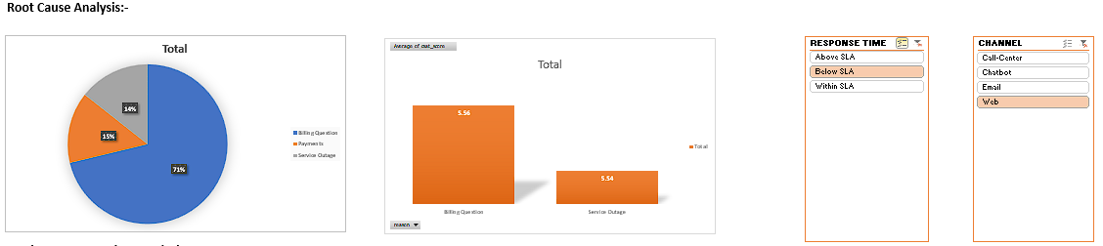
Evaluation of Database:-
Root Cause Analysis: Investigate common customer complaints. Pinpoint recurring problems to address them proactively and prevent future escalations.
OVERALL DATA OF SENTIMENT IS SHOWN AS WELL AS REALTIONSHIP BETWEEN AVERGAE CSAT SCORE & SENTIMENT.
Overall queries are of billing questions. Web channel are mostly used to address billing question queries.
Email channel SHOWING GOOD RESULTS IN TIME RESPONSE AS IT IS HAVING HIGHER NUMBER OF BELOW SLA.

Slide 11
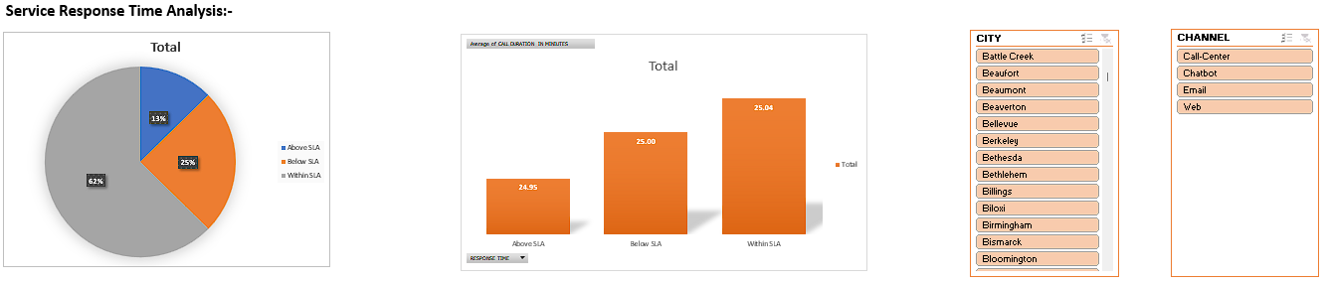
Evaluation of Database:-
Service Response Time Analysis: Analyze response times for customer queries and support requests to assess the efficiency of the customer service team.
Overall RESPONSE TIME IS SHOWN AS WELL AS response time relationship between average call duration is shown.
it is observed that efficiency of call centre is much higher because below sla is higher in call Centre.

Slide 12
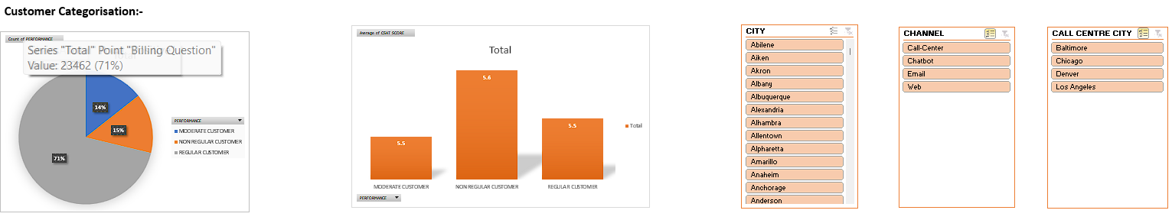
Evaluation of Database:-
Customer Segmentation: Segment customers based on their demographics, behavior, and preferences. Understand different customer segments' needs and pain points to tailor services and communications accordingly.
CUSTOMERS ARE SEGEREGATED IN REGULAR,NON REGULAR & MODERATE CUSTOMERS ON THE BASIS OF REASON & RELATIONSHIP
Overall data shows that most of the customers are regular because billing questions are common.

Slide 13
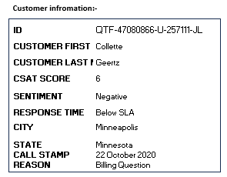
Deployment of Database:-
Deployment is done with help of ms excel.
USING PIVOT CHARTS & TABLE.
VLOOKUP FUNCTIONS.
VBA FUNCTIONS.

Slide 14

Conclusion From Database:-
CSAT SCORE :- MORE CUSTOMERS SHOULD BE ENCOURAGE TO GIVE FEEDBACK ON SERVICES TO ENSURE IMPROVEMENT CUSTOMER DATA SERVICES.
CUSTOMER SENTIMENT ANALYSIS:- OVERALL POSITIVE ANALYSIS IS SHOWN , HOWEVER DUE TO UNUNAVIALBILTY OF CSAT SCORE , ACCURATE SENTIMNT ANALAYSIS WAS NOT POSSIBLE SO CUTOMER SHOLUD BE ENCOURAGE TO RECORD THE CSAT SCORE AFTER THEIR EXPERIENCES. ALTHOUGH SENTIMNT ANALYSIS IS DONE ON THE BASIS OF TIME RESPONSE.
ROOT CAUSE ANALYSIS:-BILLING QUIERIES ARE THE HIGHEST .ALSO EMAIL IS PREFERD BY CUSTOMER TO RECORD THEIR QUEREIES,MORE CHANNEL OF CUSTOMERS CAN BE USED BY CUSTOMERS TO REDUCE LOAD ON CALL CENTRES.
SERVICE TIME RESPONSE ANALYSIS:-CHAT BOT HAS LOW EFFICIENCY , BECAUSE IT HIGHES SLA ,call centre are performing well with highest number of below sla moreover email can be used as favorite preference for customer as it has highest number of time response within sla & below sla.
CUSTOMER CATEGORISTATION:-email & web are favorite preference for customers ,but for call centre are still used by regular and non regular customers.

Slide 15

THANKYOU

